Slide 1

Final Presentation
Presented by:
Prabhjot Singh (2092028)
Sana Khalil Shaikh (2091602)
Gurpreet Kaur (2091514)
Mohit Chandaliya (2091631)

Slide 2
CALCULATOR

Slide 3
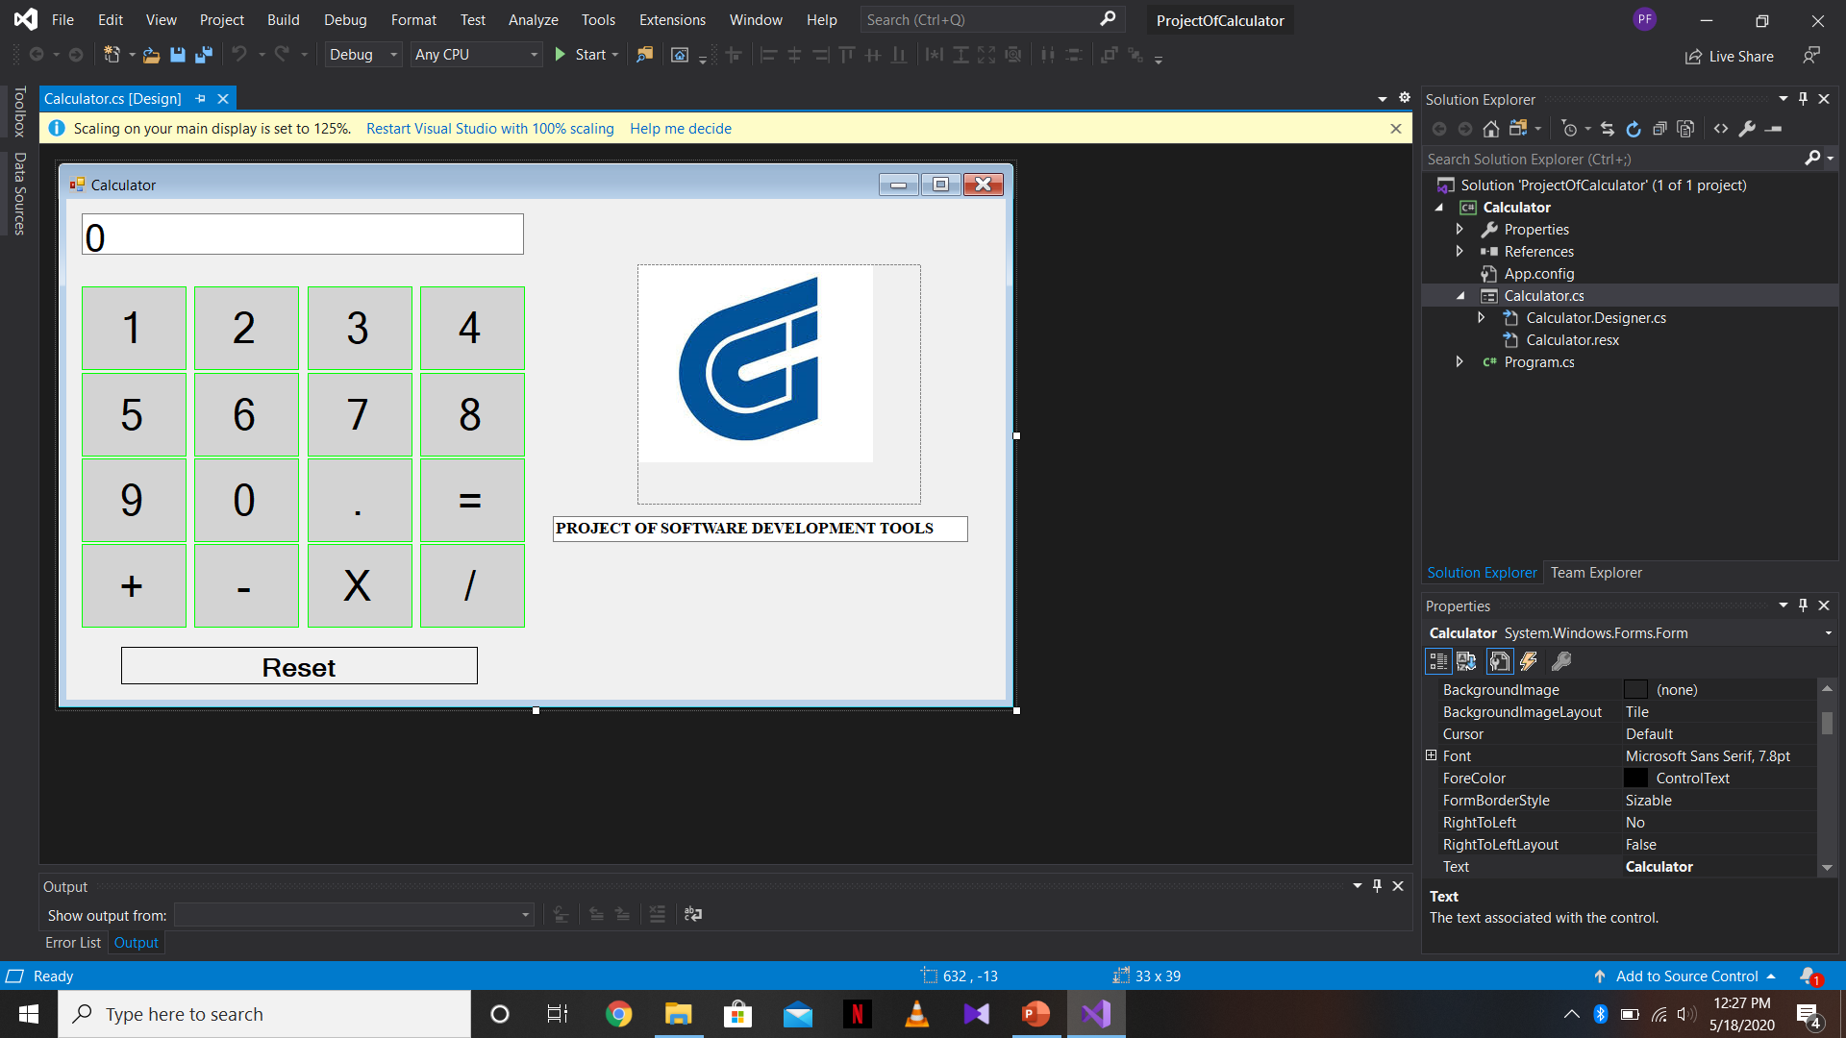

Slide 4
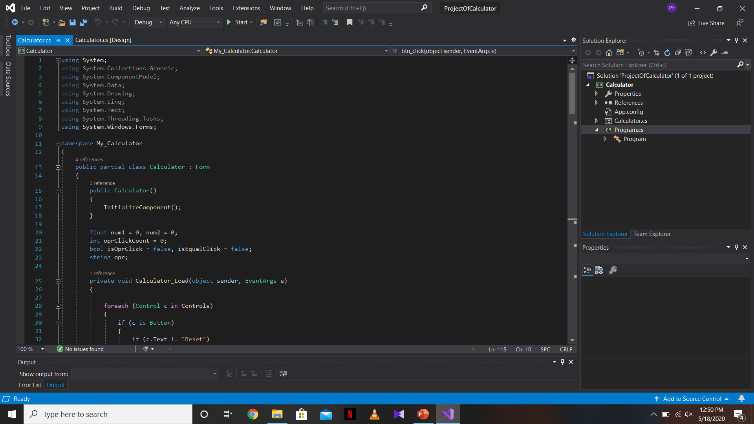

Slide 5
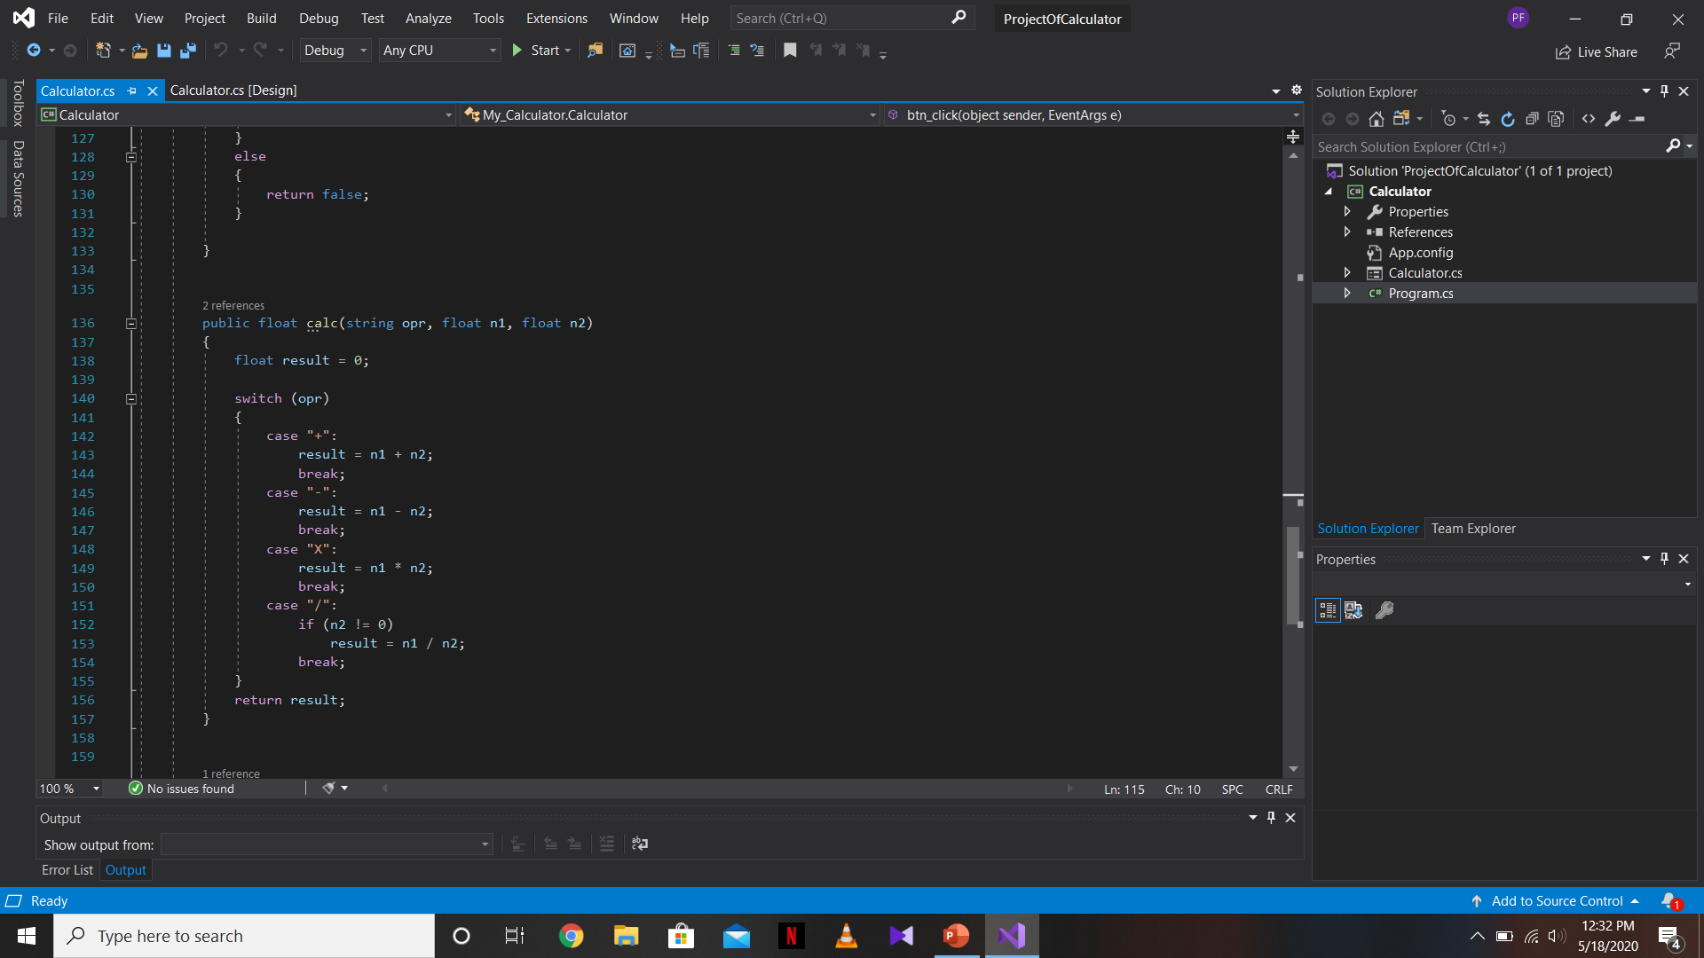

Slide 6
Calculator

Slide 7


ANY QUESTIONS

